Slide 1

Western Kansas
Groundwater Management District No. 1
LEMA PROPOSAL
Presented By Jan King, District Manager

Slide 2





In 1972 the Kansas Legislature established the Groundwater Management Act that led to the establishment of a total of five (5) local Groundwater Management Districts called GMD’s.
4
1
3
5
2
Western Kansas Groundwater Management District No. 1
was the first District established in Kansas

Slide 3
TODAY’S INFORMATION
INTRODUCTIONS
THIS IS A MEETING TO REVIEW THE LEMA PROPOSAL
BEGIN WITH A REVIEW OF THE LEMA MEETINGS
REVIEW OF WATER INFORMATION
REVIEW IMPORTANT TERMS
VOTING PROCESS
LEMA ATTACHMENT FORMS
RMA INFORMATION
FUTURE INFORMATION AND APPOINTMENTS
TIME FOR QUESTIONS

Slide 4
REVIEW
LEMA MEANS LOCAL ENHANCED MANAGEMENT AREA
LEGISLATION BEGAN TO HELP GMD4 WITH SHERIDAN 6 PROPOSAL
PROVIDES MORE LOCAL CONTROL OVER WATER
HELD 4 SETS OF MEETINGS
GREELEY COUNTY ASKED TO HOLD MEETINGS WITH WALLACE COUNTY
DECIDED TO TRY FOR A DISTRICT WIDE LEMA
PUBLIC ASKED FOR A 10% 20% AND 30% CONSERVATION PLAN
IT WAS DECIDED TO CONTINUE WITH 20%CONSERVATION PLAN
PEOPLE ASKED FOR AN 8” BOTTOM CAP
A TOP CAP WAS DISCUSSED BUT NOT FAVORED
IT WAS DECIDED TO PURSUE A 6 YEAR LEMA
COMPARISON YEARS WILL BE 2008 – 2012
IRRIGATION UNITS BECAME CONSOLIDATED WELL UNITS
FOR ADDITIONAL FLEXIBILITY LEMA TERM PERMITS WERE DEVELOPED

Slide 5
TOTAL ACRE FEET AUTHORIZED IN GMD 1 BY TYPE OF USE
TECHNICAL REFERENCE RESOURCE: KANSAS GEOLOGICAL SURVEY

Slide 6
GMD1 AUTHORIZED ACRE FEET & ACRES COMPARED
TO GMD1 AVERAGE ACRE FEET & ACRES USED FROM 2007 - 2011
TECHNICAL REFERENCE RESOURCE: KANSAS GEOLOGICAL SURVEY

Slide 7
RATE OF CHANGE
(Recorded in tenths of a foot.)
FROM 1997 TO 2014 TOTAL DECLINE WAS 10.97’
WHICH IS AN AVERAGE OF .609’ PER YEAR OR 7.313 INCHES
TECHNICAL REFERENCE RESOURCE: KANSAS GEOLOGICAL SURVEY

Slide 8
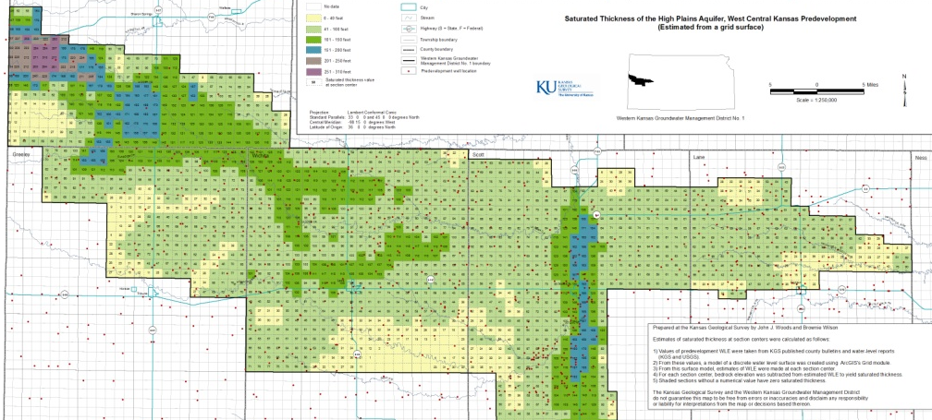
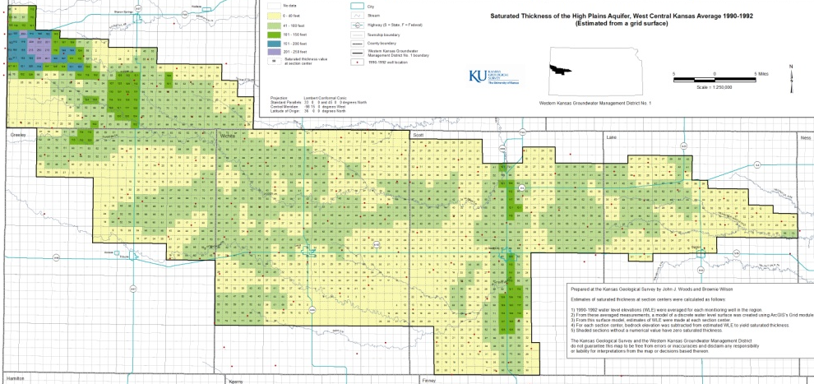

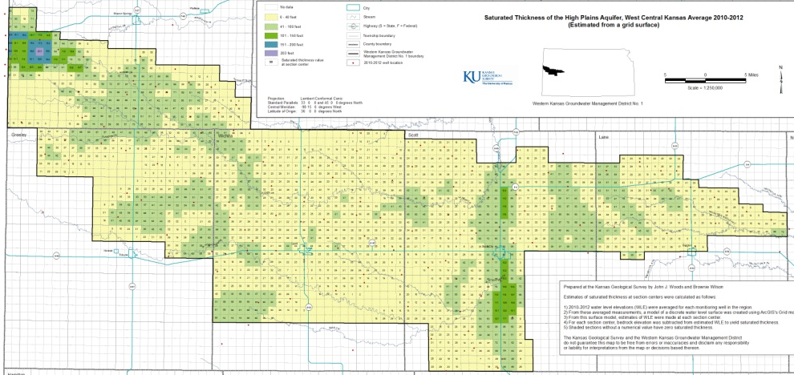
SATURATED THICKNESS PREDEVELOPMENT
SATURATED THICKNESS 1990 - 1992
No data
0 – 40 ft
41 – 100 ft
SATURATED THICKNESS PREDEVELOPMENT TO 2010 - 2012
101 – 150 ft
151 – 200 ft
201 – 250 ft
251 – 310 ft
TECHNICAL REFERENCE RESOURCE: KANSAS GEOLOGICAL SURVEY

Slide 9
DISTRICT WIDE AVERAGE ACRE FEET USED 2008 - 2012
# Wells | % of Wells |  | INCHES CATEGORY | WALLACE | GREELEY | WICHITA | SCOTT | LANE | TOTALS | %
375 | 21.6 |  | 0-7.9" | 2614.16 | 1921.09 | 8923.45 | 4929.89 | 1129.698 | 19518.29 | 10.23%
242 | 13.9 |  | 8-9.9" | 4089.4 | 1845.99 | 9350.17 | 5279.45 | 1512.405 | 22077.42 | 11.57%
280 | 16.1 |  | 10-11.9" | 7597.73 | 2474.5 | 10826.08 | 8539.55 | 3256.673 | 32694.53 | 17.14%
232 | 13.4 |  | 12-13.9" | 7522.21 | 4382.43 | 7413.52 | 7205.17 | 2745.329 | 29268.66 | 15.34%
223 | 12.8 |  | 14-15.9" | 10355.56 | 4111.15 | 7563.26 | 6964.94 | 3336.117 | 32331.03 | 16.95%
160 | 9.2 |  | 16-17.9" | 7124.08 | 3108.38 | 6036.71 | 4231.24 | 2470.793 | 22971.2 | 12.04%
114 | 6.5 |  | 18-19.9" | 7281.87 | 1707.37 | 1848.1 | 3973.68 | 1472.38 | 16283.4 | 8.54%
114 | 6.5 |  | 20+" | 4593.02 | 1715.03 | 3809.85 | 3530.99 | 1978.6 | 15627.49 | 8.19%
 |  |  | TOTAL AVE AC FT | 51178.03 | 21265.94 | 55771.14 | 44654.91 | 17902 | 190772

Slide 10
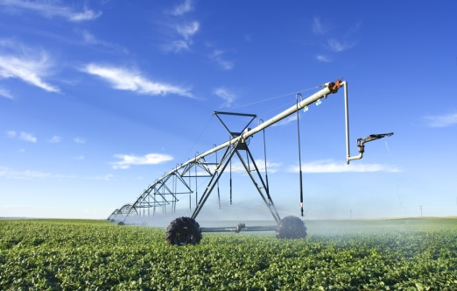
TWO IMPORTANT TERMS
ANNUAL AUTHORIZED QUANTITY
Annual Amount of water Originally given to a Water Right by the Kansas Division of Water Resources when the Water Right was Approved or Certified and as Modified by any Subsequently Approved Changes or Reductions
LEMA ALLOCATED QUANTITY
Total Quantity of Water Allowed by this 6 Year LEMA Management Plan that may be diverted by pumping during the years of 2015, 2016, 2017, 2018, 2019 & 2020

Slide 12
CONSOLIDATED WELL UNIT (CWU)
Multiple Irrigation Wells Must Be Physically Tied Together Prior to 1-1-15
CWU Form Will Provide Each Water Right’s Annual Authorized Quantity
LEMA Allocated Quantities of Each Water Right Will Be Added Together
EXAMPLE: Annual Auth. 08-12 Ave. LEMA Allocated 6 Year LEMA
x 80%
Water Right A 300 AF 200 AF 160 AF X 6 960
Water Right B 250 AF 150 AF 120 AF X 6 720
Water Right C 400 AF 80 AF 64 AF X 6 384
Total CWU 6 Year LEMA 2064 AF
A Well in the CWU can Exceed its Individual LEMA Allocated Quantity as long as it Does NOT Exceed its Annual Authorized Quantity and Does NOT Exceed the Total 6 Year LEMA Allocated Quantity

Slide 13
LEMA TERM PERMIT (LTP)
LTPs are for Irrigation Water Rights
LEMA Allocated Quantities of Each Water Right Will Be Added Together
Annual Auth 08-12 AVE LEMA Allocated 6 Year LEMA
x 80%
Water Right A 300 AF 200 AF 160 AF X 6 960
Water Right B 250 AF 150 AF 120 AF X 6 720
Water Right C 400 AF 80 AF 64 AF X 6 384
Total CWU 6 Year LEMA 344 AF X 6 2064 AF
A Well in the LTP can Exceed its Individual LEMA Allocated Quantity and can Exceed its Annual Authorized Quantity as long as the Total 6 Year LEMA Allocated Quantity is not Exceeded.

Slide 14
VOTING
Paper Ballots will be Used
Must be at least 18 years of age
Must be an Owner or a Water Use Correspondent on File with DWR
One Person One Vote Tied to One Water Right
Each Water Right May Only be Used Once for Voting
Must be Present to Vote
Voting will be held at GMD 1 Office May 27 – 30, 2014 During Regular Office Hours
Will have People sign by their Water Right Number
Voting will be held in Each County from 9:00 a.m. to 5:30 p.m.
The County Clerk has been asked to Tally the Votes in Each County
The Tally of Votes will be Kept Confidential Until the June 17th Board Meeting

Slide 19
BOARD GUIDELINES
---Information generated by the KGS, DWR and USGS will be the official source of information for GMD1 to determine a fair and appropriate allocation for appealed water rights.
---GMD1 will assign the appealed allocation to the appropriate water right and/or point of diversion.
---GMD1 will use township and section maps to determine the initial allocation.
---GMD1 may use various diameter circles, such as 2 mile or 5 mile to further define the allocation.
---GMD1 will review the appropriate saturated thickness maps to support the allocation.
---GMD1 will use DWR Water Use Report information to determine the historical acre-feet pumped per water right and/or point of diversion.
---GMD1 will use the Water Right Permit’s appropriated acres for the irrigated acres for both the neighboring comparison water rights and for the appealing water right.
---GMD1 will develop and refine these guidelines as this process goes forward.
---GMD1 will consult with DWR while developing and/or
refining these guidelines to insure they are
practical and legal.

Slide 20
RMA REDUCED IRRIGATION OPTIONS
  Option 1: is to plant fewer irrigated acres and report the rest of the planted acres as non-irrigated.
  Option 2: is to continue to plant all your acres with limited water and insure them under a non-irrigated practice.
However, If your acreage falls within the LEMA, a 3rd Option exists:
Option 3: is to request a limited irrigation yield by written agreements.
RMA will allow written agreements for limited irrigation practices in locations in a
Local Enhanced Management Area (LEMA).

Slide 21
Jan King
District Manager
VISIT OUR WEBSITE: www.gmd1.org
FOLLOW US ON TWITTER

Slide 22
Jan King
District Manager
VISIT OUR WEBSITE: www.gmd1.org
FOLLOW US ON TWITTER

